Slide 1

Emerging Technologies
Session #06: Deploying the application in Bluemix using CloudFoundry CLI
IBM Bluemix
The Digital Innovation Platform
Sylvain-Roch WILBERT
s_wilbert@fr.ibm.com
Université Paris - Dauphine

Slide 2

CloudFoundry in a nutshell
Cloud Foundry is
an open source cloud computing platform as a service (PaaS). It is an industry standard platform for cloud applications
It enables a tool to deploy applications in the cloud : cf Command Line Interface
cf api https://api.ng.bluemix.net (US South Region)
or cf api https://api.eu-gb.bluemix.net (UK Region)
cf login -u YOUR_EMAIL -o YOUR_ORG -s YOUR_WORKSPACE
cf push YOUR_APPNAME -m 512m

Slide 3
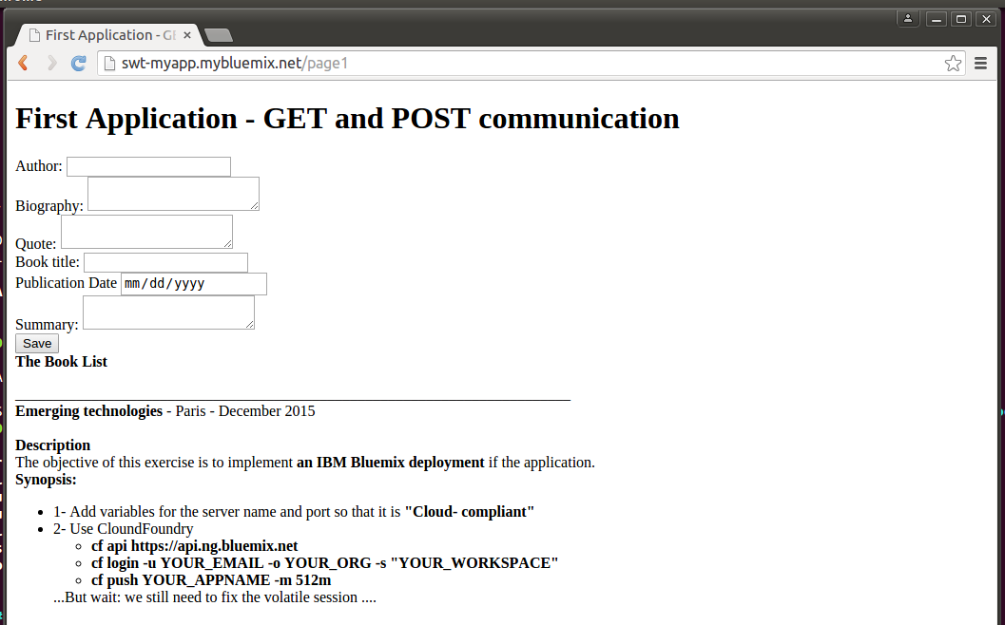
Exercize 04 - CloudFoundry
Directory : 04-andnowinbluemix

Slide 4
Exercize 03 - NodeJS basics Our requirements
Start from a stable application for ex 03-abitmorecomplex
Adapt the code in order to
Run the application locally (Design/Implementation time)
Run the application on cloud ( Run time)
Rely on Cloud Foundry to push the code on Bluemix
Cloud compliance
A default JS file shall be target (instead of relying on node filename.js)
Adapt the code in order detect when run locally or in the cloud (detecting automatically de host and port)

Slide 5
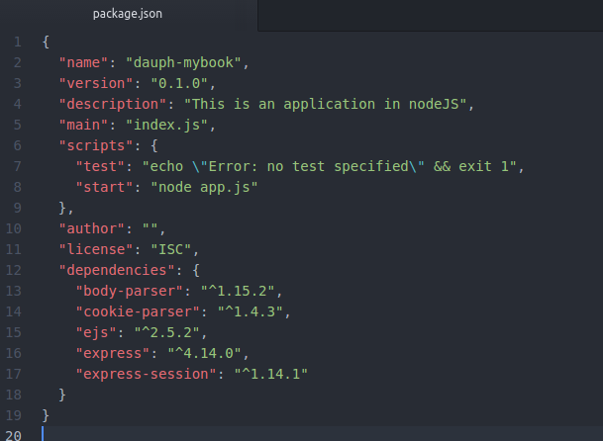
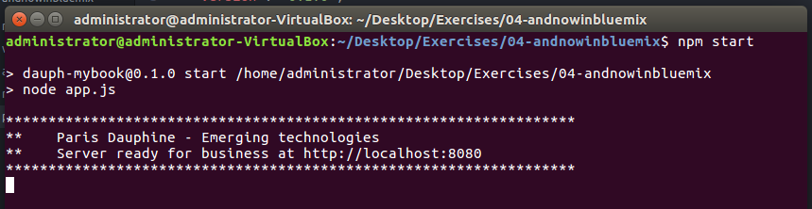
Exercize 04 - CloudFoundry Preparing the file to be Cloud compliant
Update the Package.json with a start directive
A generic command start the app : npm start

Slide 6
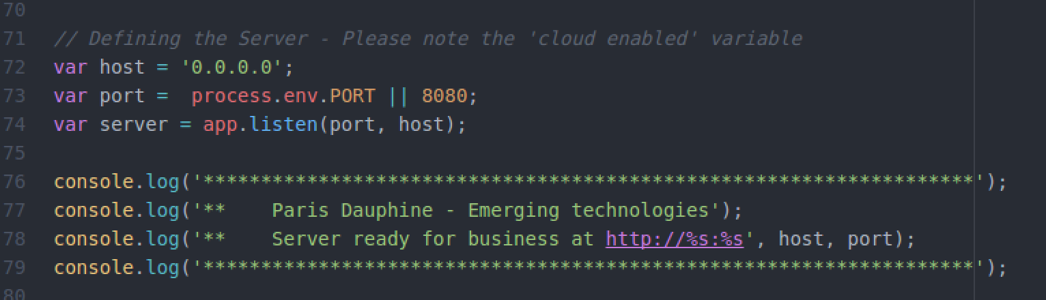
Exercize 04 - CloudFoundry
Update the app.js in order to determine the server and port in adequation with the location where the app resides.
Cloud variable
Local variable

Slide 7
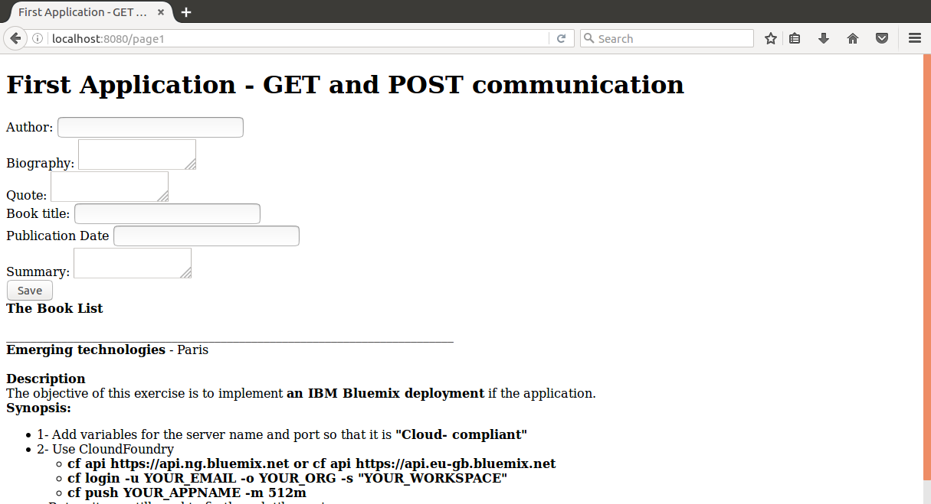
Exercize 04 – CloudFoundry Push the application to Bluemix using cloud foundry commands
BEFORE
It works on your local laptop

Slide 8
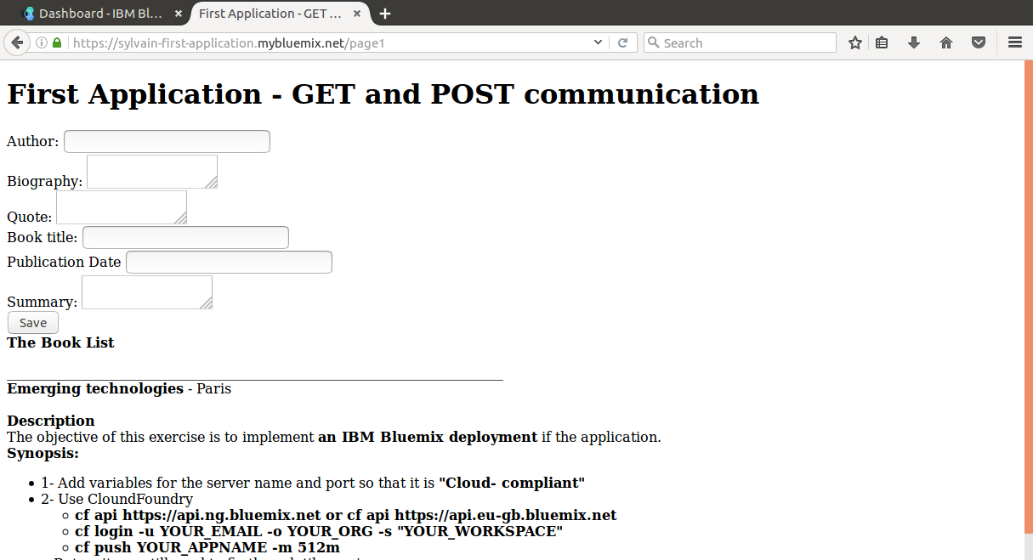
Exercize 04 – CloudFoundry Push the application to Bluemix using cloud foundry commands
AFTER
Publish your application in the cloud, in less than 5 minutes…

Slide 9
Exercize 04 – CloudFoundry Push the application to Bluemix using cloud foundry commands
Pushing your application to the cloud…..
What you will need:
Your Bluemix credentials (user and password)
The name of your region : US-SOUTH (https://api.ng.bluemix.net )
The name of your organization : email (?)
The name of your space: dev (?)

Slide 10
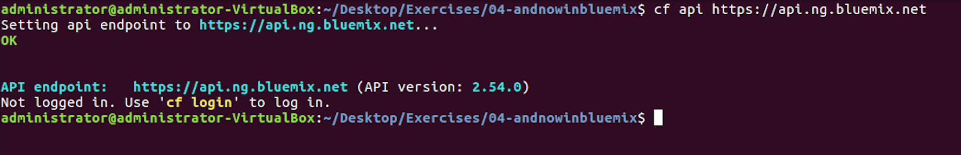
Exercize 04 – CloudFoundry Push the application to Bluemix using cloud foundry commands
Pointing to the US south region
cf api https://api.ng.bluemix.net

Slide 11
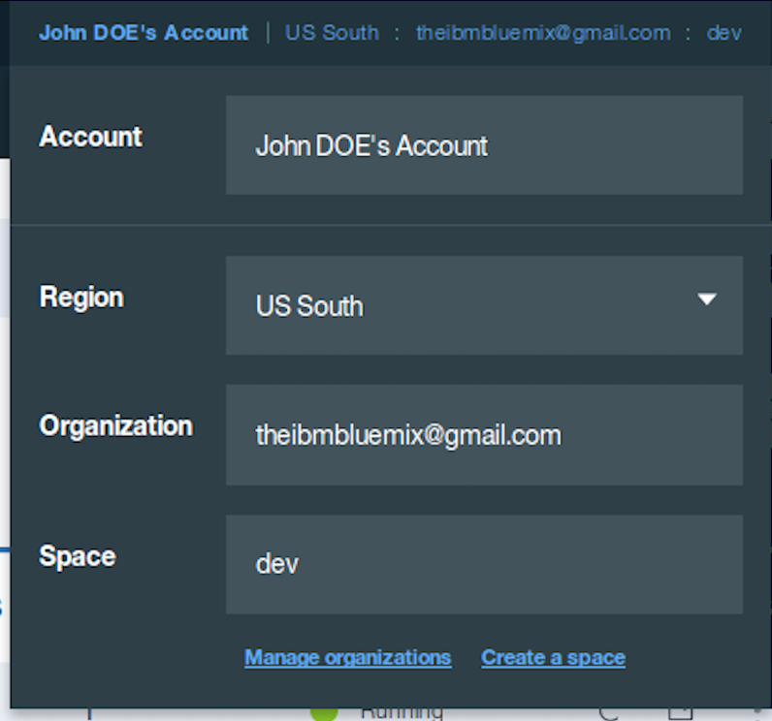
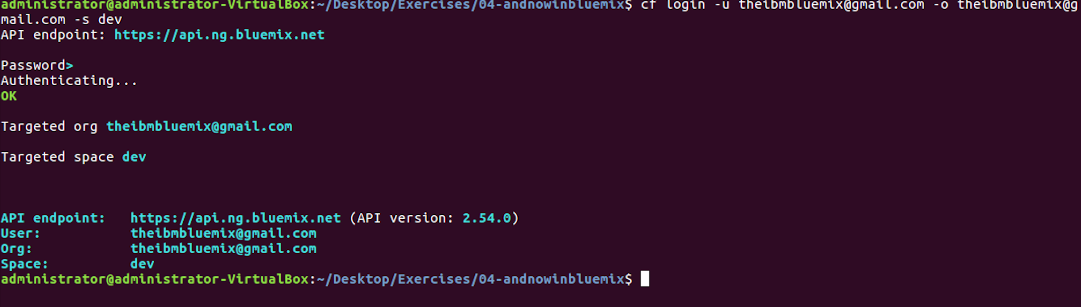
Exercize 04 – CloudFoundry Push the application to Bluemix using cloud foundry commands
Login to bluemix from a terminal
cf login -u YOUR_EMAIL -o YOUR_ORG
-s YOUR_WORKSPACE
cf login -u theibmbluemix@gmail.com -o theibmbluemix@gmail.com -s dev

Slide 12
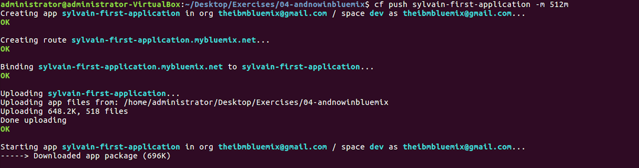
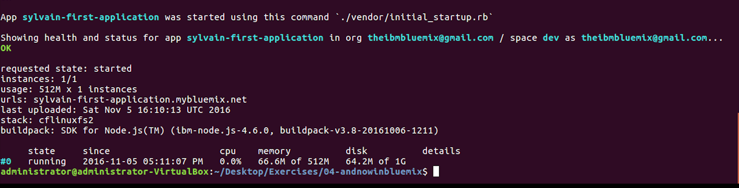
Exercize 04 – CloudFoundry Push the application to Bluemix using cloud foundry commands
cf push YOUR_APPNAME -m 512m
The application is
pushed to the cloud,
configured with 512m of memory,
published on the internet with your name.

Slide 13
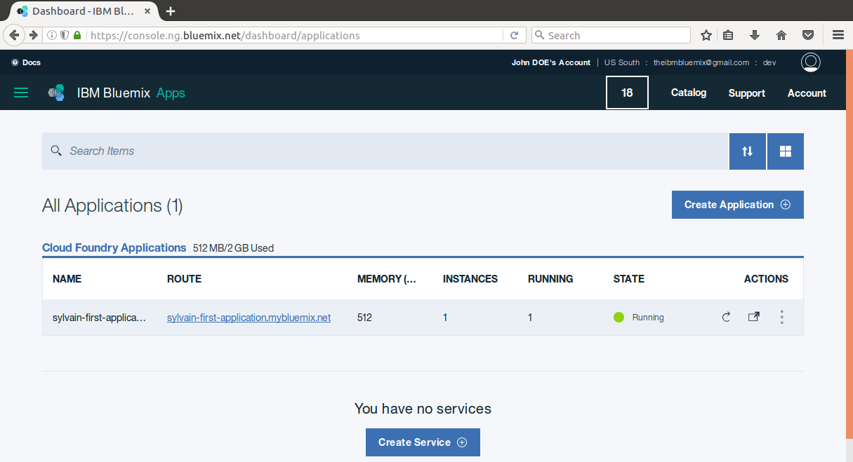
Exercize 04 – CloudFoundry Push the application to Bluemix using cloud foundry commands
The application can be monitored from the Bluemix Dashboard.

Slide 14
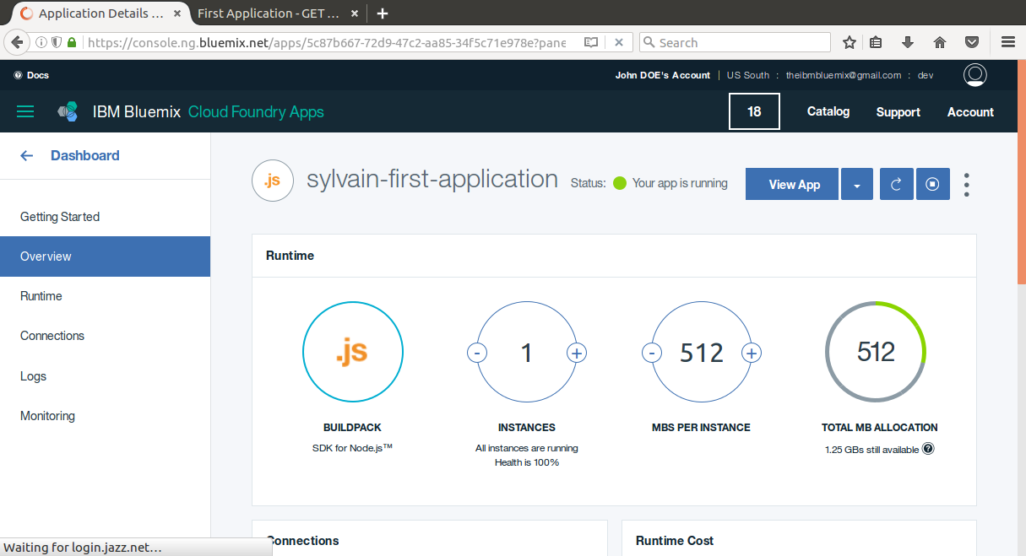
Exercize 04 – CloudFoundry Push the application to Bluemix using cloud foundry commands

Slide 15
Exercize 04 – CloudFoundry Push the application to Bluemix using cloud foundry commands

